Slide 1
Process for application for ENQA membership and EQAR listing
Dr. Padraig Walsh
President, European Association for Quality Assurance in Higher Education (ENQA) and Chief Executive, Quality and Qualifications Ireland (QQI)
Meeting with Higher Education Quality Assurance Council, Riga, Latvia, 1 December 2015

Slide 2
What is ENQA?
ENQA is the European Association for Quality Assurance in Higher Education
ENQA is a membership organisation of external Quality Assurance Agencies
The criteria for membership is that an agency undergoes a successful external review against the 2015 European Standards and Guidelines (ESG) every five years

Slide 3
ENQA Strategic Plan 2016-20 Goal 1
REPRESENTATION
ENQA is representative of the diversity of quality assurance agencies throughout Europe
ENQA supports the continuous development of independent and trustworthy quality assurance agencies operating in line with agreed standards throughout Europe
ENQA provides advice and represents the interests of its members in the policy-making process

Slide 4
ENQA Strategic Plan 2016-20 Goal 2
SERVICES
ENQA is a fruitful network for agencies throughout Europe
ENQA is the preferred partner for reviews against agreed European standards
ENQA is a key source of reliable information, expertise and know-how on quality assurance
ENQA is a reference point for European quality qssurance in the international context

Slide 5
ENQA Strategic Plan 2016-20 Goal 3
QUALITY ENHANCEMENT
ENQA contributes to the enhancement and innovation of quality assurance

Slide 6
ENQA at a glance
Established as a network in 2000
Based in Brussels
Permanent Secretariat of 5
Elected Board of 9 members
President
2 Vice-Presidents
Treasurer
5 ordinary members
Term of office of Board members is 3 years (renewable once)

Slide 7
ENQA at a glance
48 full members from 26 EHEA countries
46 affiliates (including AIC, Latvia) from a further 15 countries
ENQA is representative of 41 of the 48 members of the EHEA
Affiliates in the USA, Ecuador, Hong Kong, Israel and Jordan

Slide 8
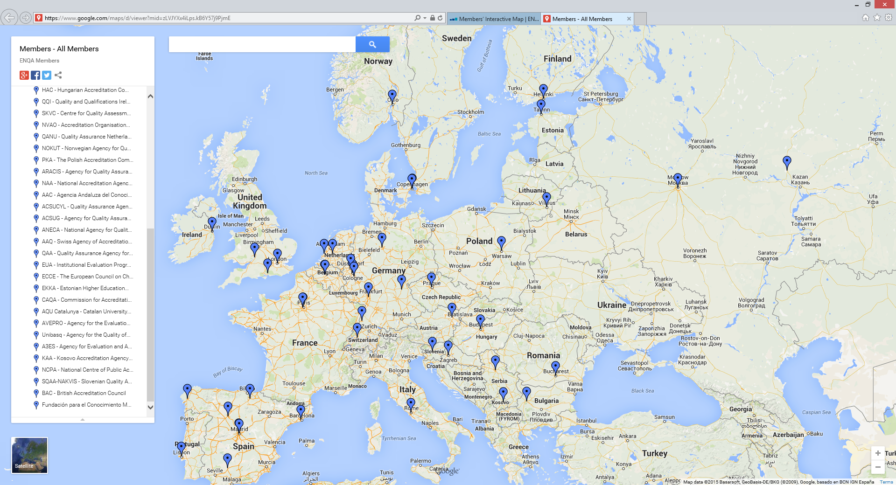
ENQA – member agencies

Slide 9
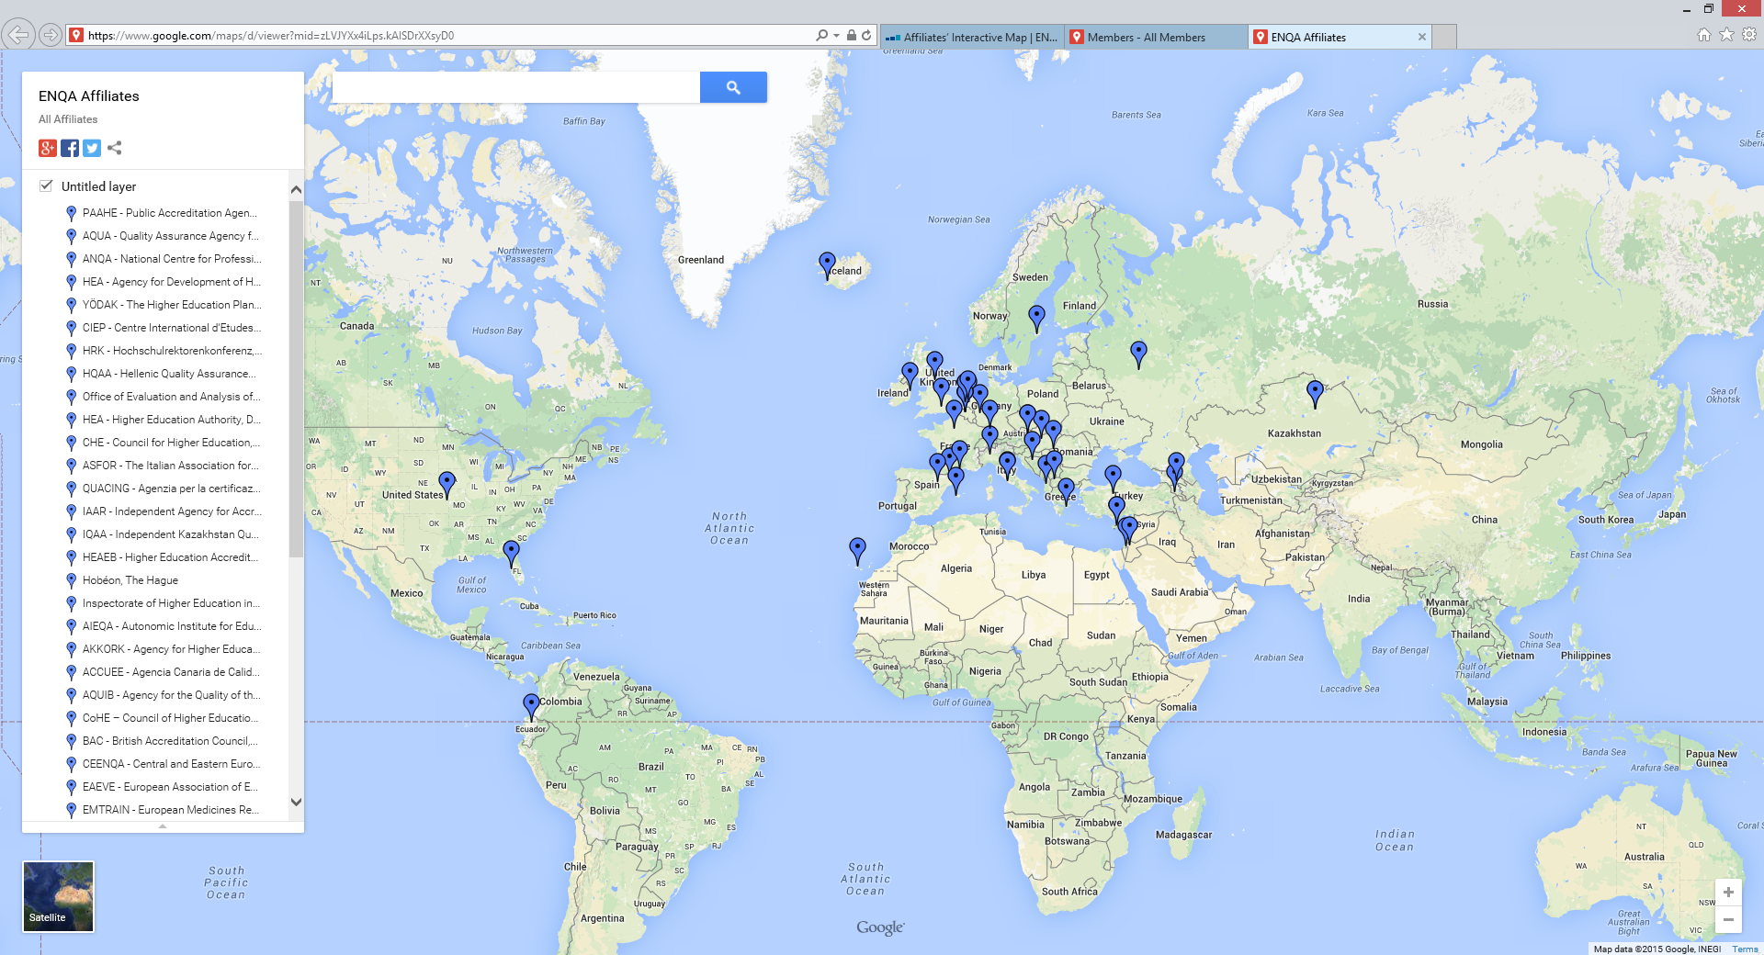
ENQA - affiliates

Slide 10
ENQA activities
ENQA
organises a Members Forum in April and a General Assembly in October each year
participates as the lead or as a partner in projects funded by the European Commission (ERASMUS+, for instance)
organises self-funded projects for members (QPP series)
Participates as a consultative member in the Bologna Follow-up Group
organises workshops, seminars, conferences and networking events for members
organises reviews of member or applicant agencies against the 2015 European Standards and Guidelines

Slide 11
ENQA activities - 2015
January – ASIA Pacific Regional Forum, Macau
April – 5th ENQA Members’ Forum, Cordoba
June – 15 years of QA in Europe, ENQA networking event, Brussels
October – 6th ENQA General Assembly, Dublin
November – 10th European Quality Assurance Forum, London
December - ENQA Workshop on Quality Assurance and e-learning, Barcelona

Slide 12
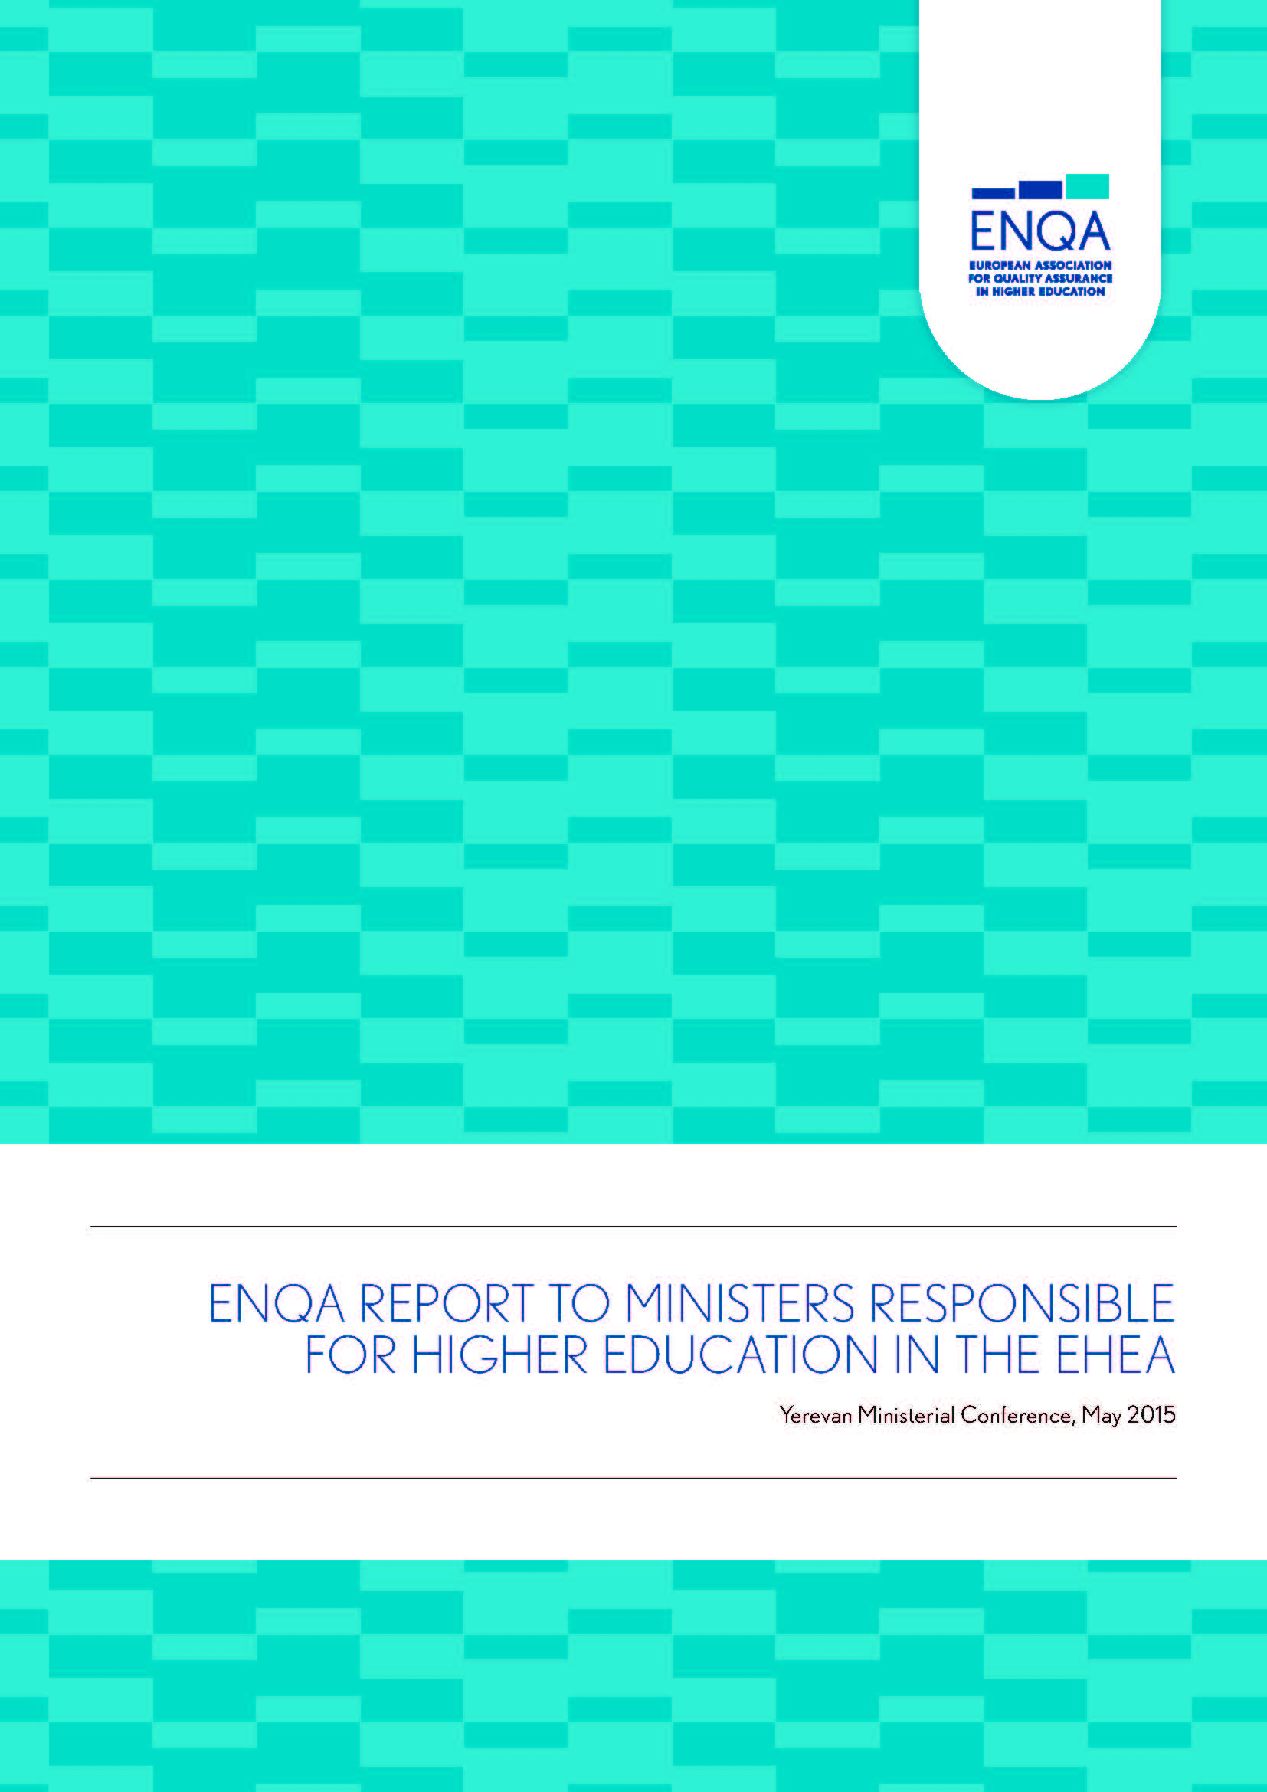
ENQA Report to Ministerial Conference (Yerevan, May 2015) QA in the EHEA - Priorities for the future
Internationalisation of Quality Assurance and the Revised ESG
Benefits and Risks of Cross Border Quality Assurance Services
Transparency and Availability of Quality Assurance Reports
Independence of Quality Assurance Agencies

Slide 13
ENQA – Reviews of agencies
ENQA organises reviews of applicant or member agencies
ENQA trains panels of reviewers
ENQA membership criteria is a finding of substantial compliance with ESG 2015 following a review

Slide 14
ENQA – Reviews of agencies
Panel usually consists of 5 members
One or two quality assurance professionals (at least one of whom should be currently employed by a QA agency)
An academic currently serving at a higher education institution
A student member
A member of the ENQA Secretariat (new since 2015)
When requested by the agency under review, other stakeholders members (e.g. from the labour market) may be included instead of the second quality assurance professional or in addition to the 5 panel members

Slide 15
ENQA – Reviews of agencies
Panels are appointed from among experts nominated by
ENQA
EUA or EURASHE
ESU
BusinessEurope
All panel members must have undergone training by ENQA
At least two panel members must come from outside the national system of the agency under review
At least one member of the panel has good knowledge and understanding of the higher education and quality assurance system in which the agency (predominantly) operates

Slide 16
Stages in ENQA Review (I)
Application from (current or applicant) member to ENQA to co-ordinate review
Agreement of Terms of Reference between agency and ENQA
Agency produces self-assessment report (SAR)
ENQA Secretariat carries out an administrative scrutiny of the SAR to verify if it meets the requirements
Appointment of external panel
Site visit to the agency by panel

Slide 17
Stages in ENQA Review (II)
Panel drafts external review report
Report sent to agency for factual checking
Panel judgement is provided for each standards with the following grading:
Fully compliant
Substantially compliant
Partially compliant
Non-compliant
Report submitted to ENQA Board

Slide 18
Stages in ENQA Review (III)
Report is sent to one of the ENQA scrutiny committees
2 Board members and (usually) 1 ex-Board member
Report is considered by the full ENQA Board
Board decides if the agency is accepted (or reconfirmed) as a member
ENQA publishes the external review report (irrespective of whether the decision was negative or positive)
Membership is valid for five years from the date of the Board meeting
Applicant can appeal a negative finding to the ENQA Appeals Committee

Slide 19
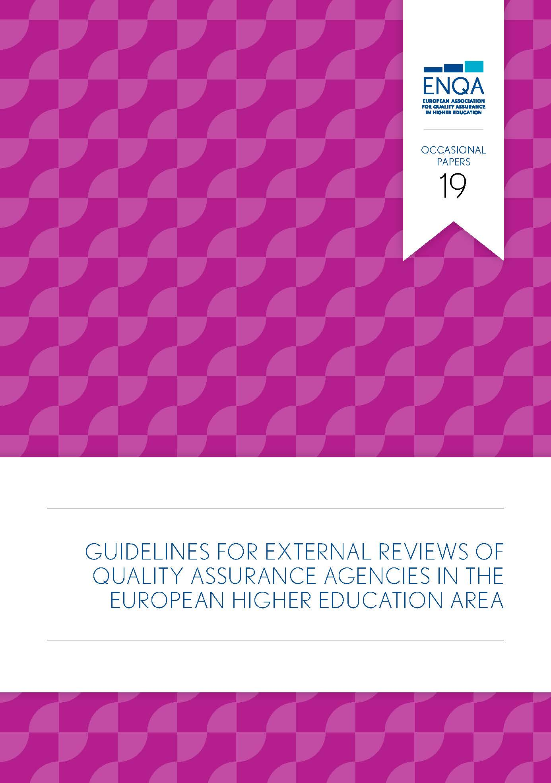
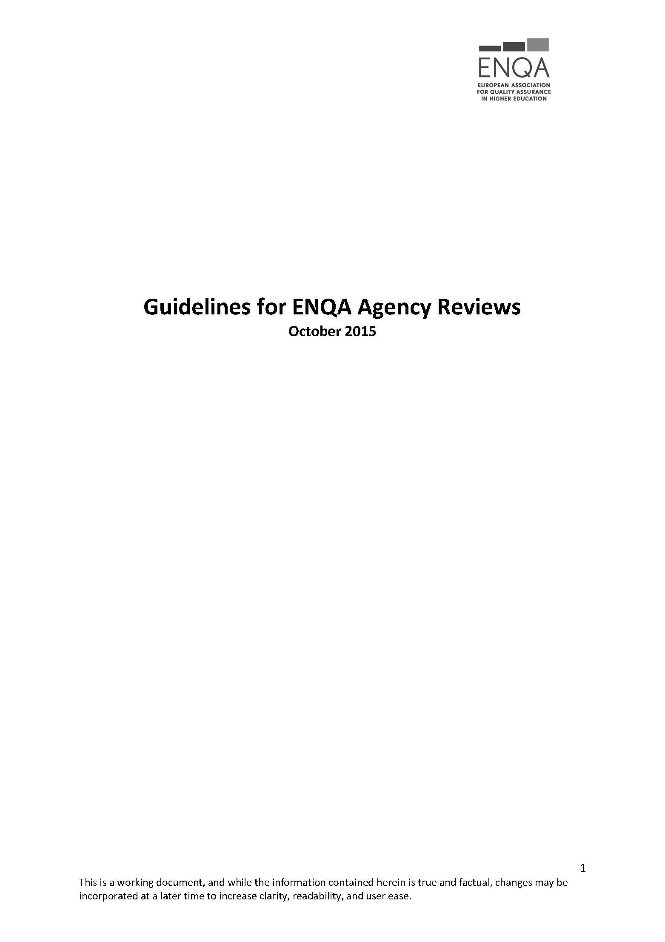
Guidelines for ENQA Agency Reviews
Working document – October 2015

Slide 20
Membership of ENQA and listing on EQAR (November 2015)
48 members from 26 EHEA countries
39 agencies listed from 20 EHEA member countries
There are 38 agencies that are members of ENQA and are listed on EQAR

Slide 21
Application for listing on EQAR
DISCLAIMER: the following information is a synopsis of material available on the EQAR website www.eqar.eu
All details should be checked with the EQAR Secretariat.
The European Quality Assurance Register for Higher Education is a list of agencies that have undergone a review and have been found to be substantially compliant with the European Standards and Guidelines
The founding members of EQAR are ENQA, EUA, EURASHE and ESU
The other members are national governments and consultative members; Education International and Business Europe
The decisions of listing on EQAR are taken by the Register Committee
EQAR requires an applicant agency to commission a review against the ESG
EQAR does NOT organise reviews itself
The overwhelming majority of EQAR listed agencies chose ENQA as the commissioning body for their review

Slide 22
Application for listing on EQAR
Agencies applying for inclusion on the Register (or renewal of registration) need to undergo an eligibility check before initiating their external review
As part of the verification of eligibility the applicant is expected to submit to EQAR a draft of the terms of reference for the planned external review to be agreed between the applicant and the review coordinator (e.g. ENQA).

Slide 23
Application for listing on EQAR
As EQAR does not co-ordinate reviews itself, it is the responsibility of the applicant to identify a suitable review coordinator (such as ENQA) that has the necessary professional capacity and is independent from the applicant
EQAR’s requirements in terms of the external panel composition and the site visit are fully compatible with the ENQA review model
So as to ensure that the review is conducted on a sufficient and robust basis for the Register Committee to make a decision, EQAR advises that an applicant agency and the review co-ordinator are aware of the EQAR document (2015) Use and Interpretation of the ESG

Slide 24
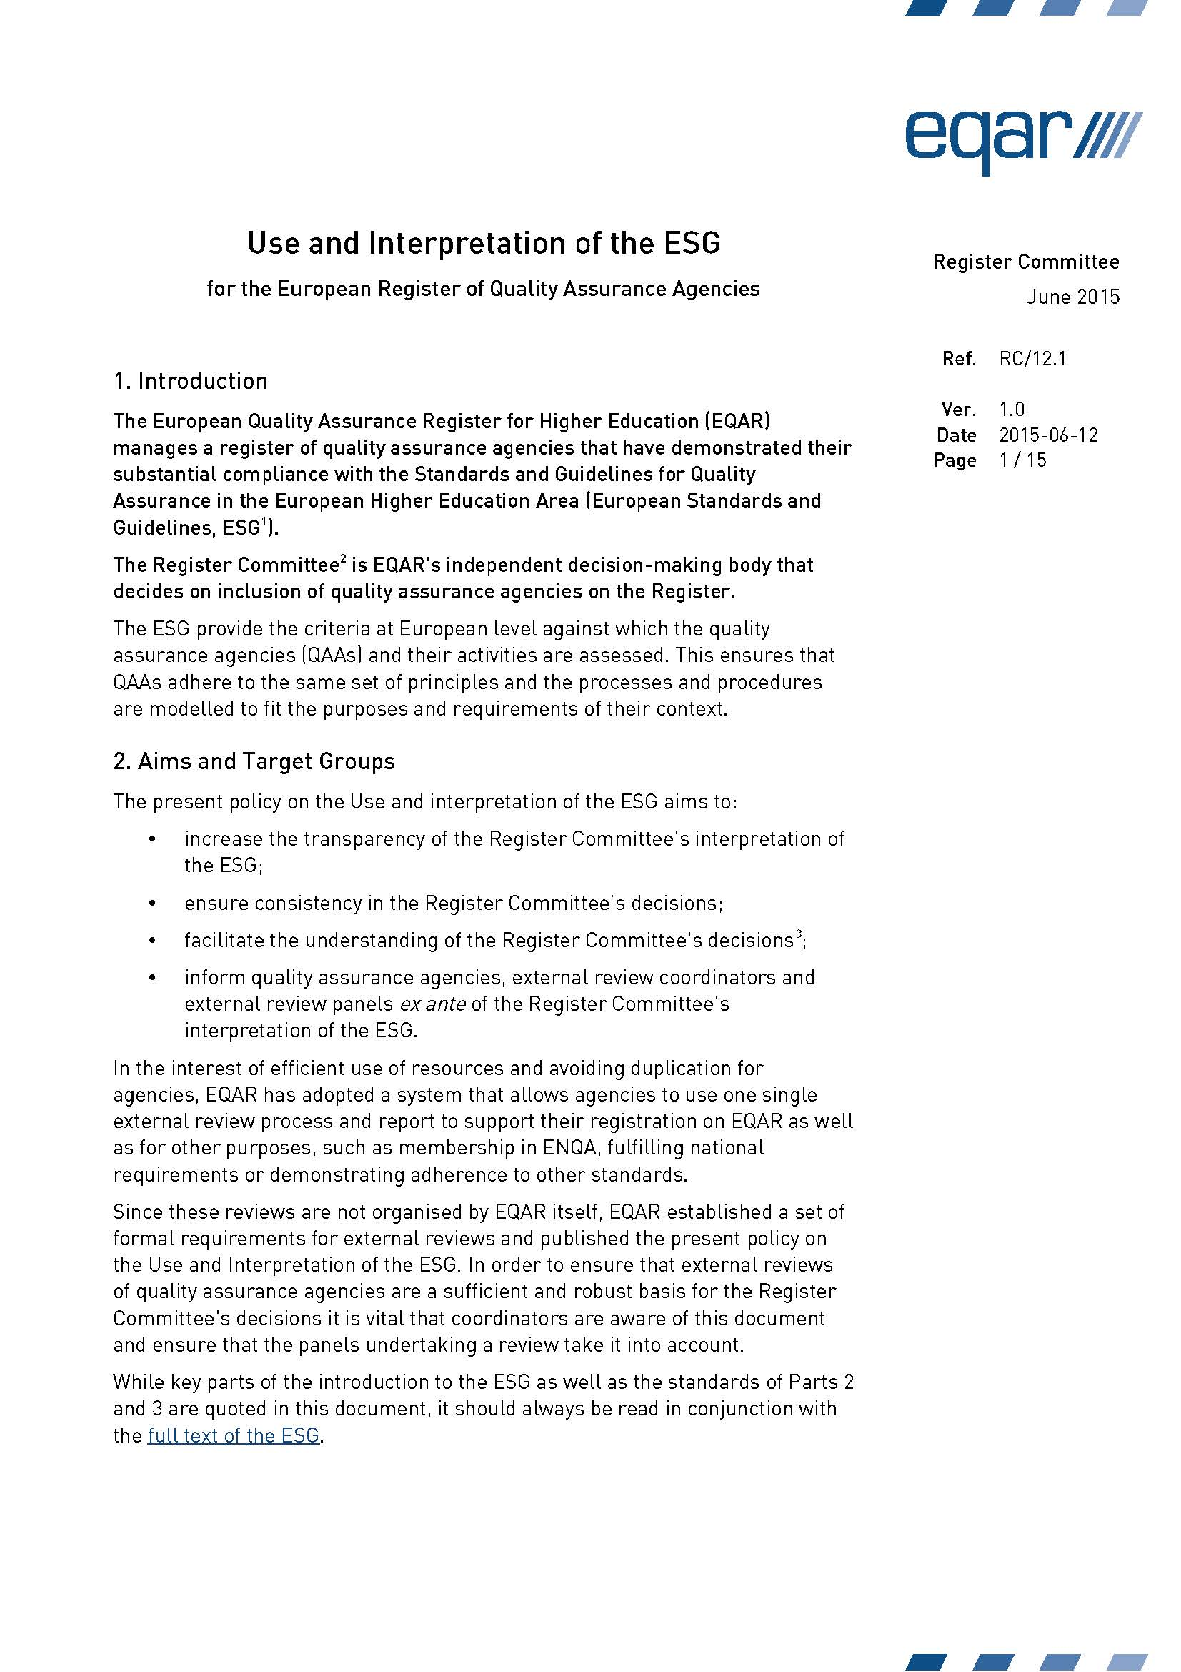
Application for listing on EQAR
Use and Interpretation of the ESG is a document published by the EQAR Register Committee in June 2015 following adoption of ESG 2015 by Ministers in Yerevan in May 2015

Slide 25
Application for listing on EQAR
The Register Committee convenes twice a year (spring and autumn). Before each meeting there is a deadline (15 March and 15 September) for which complete applications (review documents) must have reached the Secretariat in order to be considered at that meeting.
In the case of initial applications, the review documents must be submitted before one of the two deadlines (15 March / 15 September)
The EQAR Register Committee will then make a decision on admission of the agency to the Register (or renewal of its registration, respectively)

Slide 26
ENQA and EQAR – do I have to do the examination twice?
ENQA is an association of external quality assurance agencies. It represents agencies and organises projects, seminars, conferences and networking events.
ENQA offers reviews against ESG 2015 as a service to agencies. The ENQA membership criteria is a successful review against ESG 2015.
ENQA trains reviewers for and organises reviews against ESG 2015
The ENQA Board takes membership decisions based on a review report

Slide 27
ENQA and EQAR – do I have to do the examination twice?
EQAR is a listing of agencies substantially complying with ESG 2015
EQAR requires an applicant agency to commission a body to co-ordinate a review
Based on the submission of the report arising from that review, the EQAR Register Committee makes a decision on listing of the applicant agency

Slide 28
ENQA and EQAR – do I have to do the examination twice?
If an agency wishes to apply to ENQA for members and also to apply to EQAR for listing, there is no duplication of effort on the agency’s behalf other than Indicating to both organisations that they wish to apply for membership and listing
In the case of an application to ENQA, ENQA organises the review and produces the report and the ENQA Board takes a decision on ENQA membership
In the case of seeking an EQAR listing, the agency submits its review report and the EQAR Register Committee takes a decision on listing
The examination is sat once but there are two ‘examiners’. Like any good quality assurance system, if the process is consistent, the ‘examiners’ should (and usually do) come to the same conclusion

Slide 29
Thank you

