Slide 1
Developments in Quality Assurance in Europe and its impact upon higher Education Institutions
Dr. Padraig Walsh
President, European Association for Quality Assurance in Higher Education (ENQA)
AIC Conference, Riga, 30 November 2015

Slide 2
Berlin Communiqué (2003)
Ministers commit themselves to supporting further development of quality assurance at institutional, national and European level. They stress the need to develop mutually shared criteria and methodologies on quality assurance
Consistent with the principle of institutional autonomy, the primary responsibility for quality assurance in higher education lies with each institution itself
By 2005 national quality assurance systems should include:
A definition of the responsibilities of the bodies and institutions involved
Evaluation of programmes or institutions, including internal assessment, external review, participation of students and the publication of results
A system of accreditation, certification or comparable procedures
International participation, co-operation and networking

Slide 3
Berlin Communiqué (2003)
At the European level, Ministers call upon ENQA through its members, in co-operation with the EUA, EURASHE and ESIB, to develop an agreed set of standards, procedures and guidelines on quality assurance, to explore ways of ensuring an adequate peer review system for quality assurance and/or accreditation agencies or bodies, and to report back to Ministers in 2005.

Slide 4
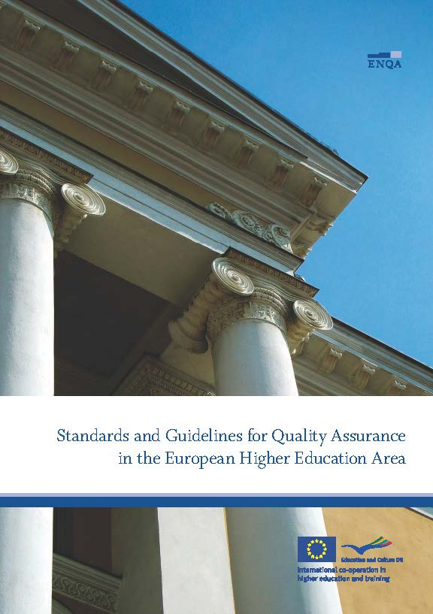
Bergen Communiqué (2005)
We adopt the standards and guidelines for quality assurance in the European Higher Education Area as proposed by ENQA. We commit ourselves to introducing the proposed model for peer review of quality assurance agencies on a national basis
ESG 2005 was published by ENQA, in association with EUA, EURASHE and ESIB
We welcome the principle of a European register of quality assurance agencies based on national review. We ask that the practicalities of implementation be further developed by ENQA in cooperation with EUA, EURASHE and ESIB

Slide 5
ENQA membership and ESG compliance
Following the adoption of the 2005 ESG by the Ministers, ENQA agreed that a finding of substantial compliance with the ESG by a quality assurance agency following an external review would become the de facto membership criteria for the association

Slide 6
London Communiqué (2007)
We thank the E4 Group for responding to our request to further develop the practicalities of setting up a Register of European Higher Education Quality Assurance Agencies.
The purpose of the register is to allow all stakeholders and the general public open access to objective information about trustworthy quality assurance agencies that are working in line with the ESG.
It will therefore enhance confidence in higher education in the EHEA and beyond, and facilitate the mutual recognition of quality assurance and accreditation decisions.
We welcome the establishment of a register by the E4 group, working in partnership, based on their proposed operational model. The register will be voluntary, self-financing, independent and transparent.
Applications for inclusion on the register should be evaluated on the basis of substantial compliance with the ESG, evidenced through an independent review process endorsed by national authorities, where this endorsement is required by those authorities.

Slide 7
Leuven & Louvain-la-Neuve Communiqué (2009)
Transnational education should be governed by the European Standards and Guidelines for quality assurance as applicable within the European Higher Education Area and be in line with the UNESCO/OECD Guidelines for Quality Provision in Cross-Border Higher Education
We reassert the importance of the teaching mission of higher education institutions and the necessity for ongoing curricular reform geared toward the development of learning outcomes. Student-centred learning requires empowering individual learners, new approaches to teaching and learning, effective support and guidance structures and a curriculum focused more clearly on the learner in all three cycles.
We ask the E4 group (ENQA-EUA-EURASHE-ESU) to continue its cooperation in further developing the European dimension of quality assurance and in particular to ensure that the European Quality Assurance Register is evaluated externally

Slide 8
Bucharest Communiqué (2012)
Quality assurance is essential for building trust and to reinforce the attractiveness of the EHEA’s offerings, including in the provision of cross-border education. We commit to both maintaining the public responsibility for quality assurance and to actively involve a wide range of stakeholders in this development.
We will revise the ESG to improve their clarity, applicability and usefulness, including their scope. The revision will be prepared by the E4 in cooperation with Education International, BUSINESSEUROPE and the European Quality Assurance Register for Higher Education (EQAR), and will be submitted to the Bologna Follow-Up Group.
We welcome the external evaluation of EQAR and we encourage quality assurance agencies to apply for registration. We will allow EQAR-registered agencies to perform their activities across the EHEA, while complying with national requirements. In particular, we will aim to recognise quality assurance decisions of EQAR-registered agencies on joint and double degree programmes.

Slide 9
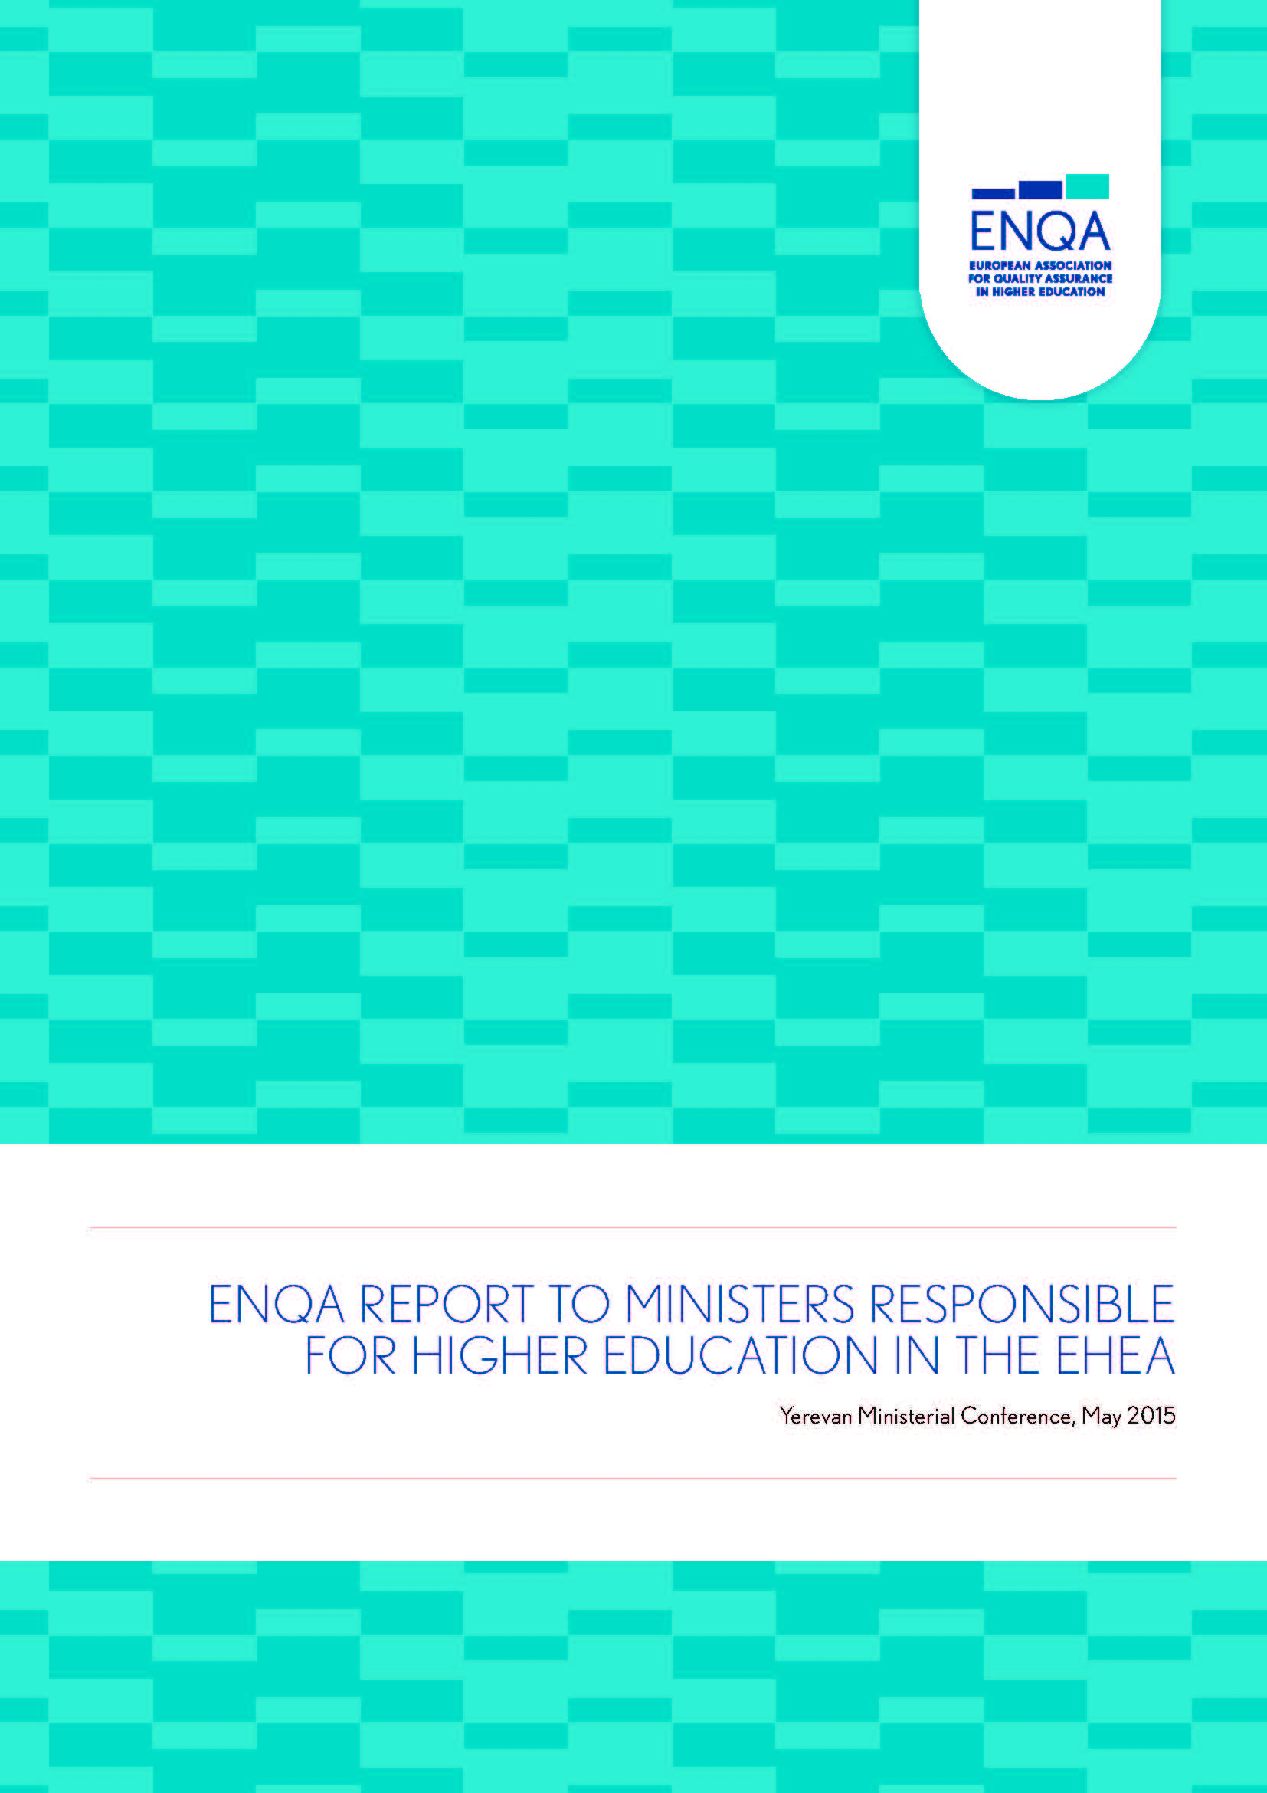
ENQA Report to Ministerial Conference (Yerevan 2015) QA in the EHEA - Priorities for the future
Internationalisation of Quality Assurance and the Revised ESG
Benefits and Risks of Cross Border Quality Assurance Services
Transparency and Availability of Quality Assurance Reports
Independence of Quality Assurance Agencies

Slide 10
Yerevan Communiqué (2015)
We will encourage and support higher education institutions and staff in promoting pedagogical innovation in student-centred learning environments and in fully exploiting the potential benefits of digital technologies for learning and teaching.
Study programmes should enable students to develop the competences that can best satisfy personal aspirations and societal needs, through effective learning activities. These should be supported by transparent descriptions of learning outcomes and workload, flexible learning paths and appropriate teaching and assessment methods.
It is essential to recognise and support quality teaching, and to provide opportunities for enhancing academics’ teaching competences. Moreover, we will actively involve students, as full members of the academic community, as well as other stakeholders, in curriculum design and in quality assurance.

Slide 11
Yerevan Communiqué (2015)
We adopt:
the revised Standards and Guidelines for Quality Assurance in the European Higher Education Area (ESG)
the European Approach for Quality Assurance of Joint Programmes
We commit:
to enable our higher education institutions to use a suitable EQAR registered agency for their external quality assurance process, respecting the national arrangements for the decision making on QA outcomes

Slide 12
ESG 2015
wider authorship – E4 plus 3

Slide 13
What does ESG 2015 mean for Higher Education Institutions
Expansion of Part 1 – Standards and Guidelines for Internal Quality Assurance from 7 to 10 Standards
Policy for quality assurance
Design and approval of Programmes
Student-centred learning, teaching and assessment
Student admission, progression, recognition and certification
Teaching staff
Learning resources and student support
Information management
Public information
On-going monitoring and periodic review of programmes
Cyclical external quality assurance

Slide 14
How HEIs can address internal quality assurance in line with ESG 2015
Helpful guide on how universities can address ESG 2015 (part 1)
Published (Sep 2105) by www.eua.be

Slide 15
Challenges (for some) with ESG 2015
1.2 – Design and approval of programmes
Programmes are designed by involving students and other stakeholders in the work
1.3 - Student-centred learning, teaching and assessment
The implementation of student-centred learning and teaching:
Respects and attends to the diversity of students and their needs, enabling flexible learning paths
Flexibly uses a variety of pedagogical methods
Encourages a sense of autonomy in the learner
2.4 - Peer-review experts
External quality assurance should be carried out by groups of external experts that include (a) student member(s)
2.6 - Reporting
Full reports should be published

Slide 16
Membership of ENQA and listing on EQAR (November 2015)
48 members from 26 EHEA countries
39 agencies listed from 20 EHEA member countries
There are 38 agencies that are members of ENQA and are listed on EQAR

Slide 17
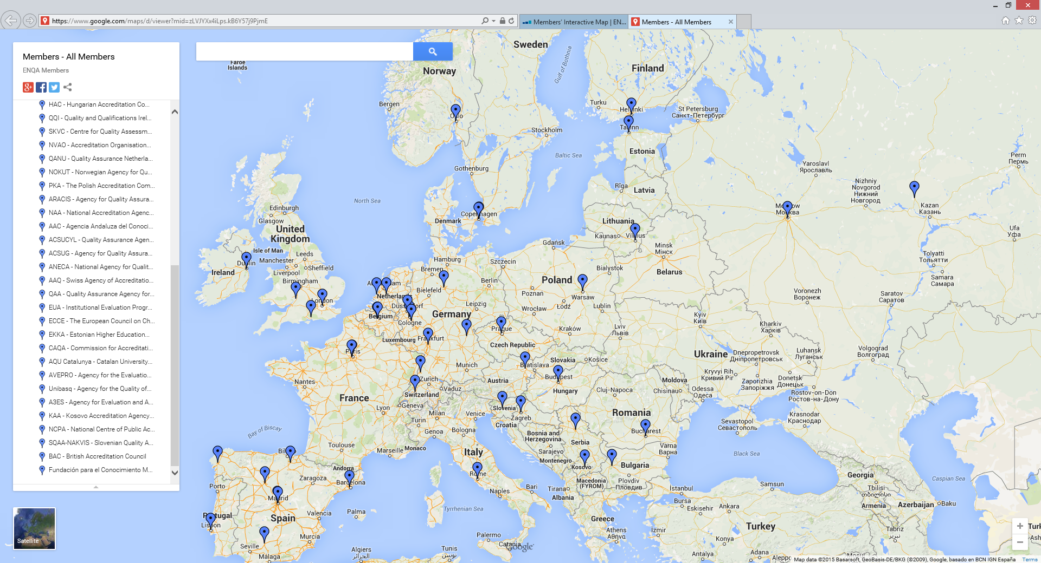
ENQA – member agencies

Slide 18
ENQA - affiliates
46 affiliates from a further 15 EHEA member countries so ENQA is now representative of 41 of the 48 members of the EHEA
Affiliates in the USA, Ecuador, Hong Kong, Israel and Jordan

Slide 19
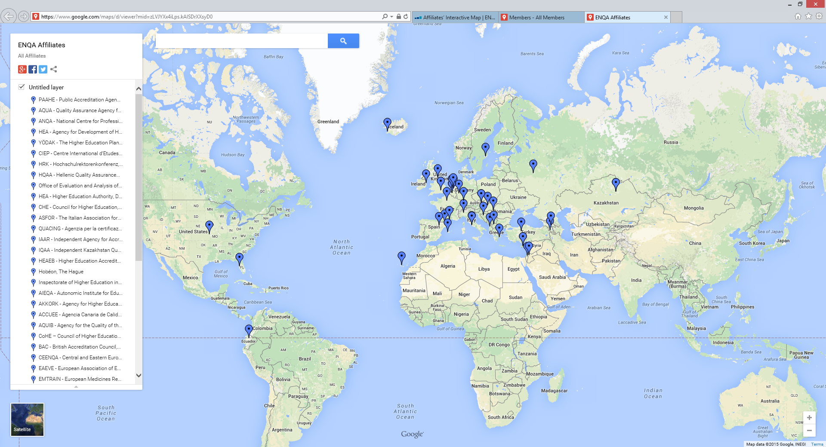
ENQA - affiliates

Slide 20
Internationalisation of Quality Assurance
The most powerful way to internationalise QA in the EHEA since 2005 has been the implementation of the Standards and Guidelines for Quality Assurance in the European Higher Education Area (ESG)
With their revision completed between 2012 and 2015, the adaption of all national systems (particularly in countries which have not yet fully developed QA systems) to the revised ESG will be an important priority

Slide 21
Internationalisation of Quality Assurance
Following the initial adoption of the ESG by the ministers in 2005, the majority of reviews of QA agencies between 2006 and 2011 were nationally organised, although ENQA was contracted to perform a small number of these reviews
Since 2012, ENQA has been the main contractor of external reviews of European QA agencies, having co-ordinated and carried out almost all of the reviews used for determining both ENQA membership and EQAR listing
In all cases, the evaluators come from countries outside the agency’s home country. This is, we believe, one of the most important contributions to the internationalisation of quality assurance and to its anchorage in the ESG.

Slide 22
Quality Assurance of Higher Education
The 2005 and 2015 versions of the ESG both recognise the diversity of higher education
Even though all ENQA members operate according to the ESG, the services they provide can be substantially different in nature (audit, assessment, accreditation, etc.) and serve different objectives
These often reflect specific national agendas and (frankly) the level of maturity of both the national higher education system and its quality assurance

Slide 23
Diversity of ENQA members
ENQA members include:
Monopoly national evaluation agencies (e.g. QQI, Ireland)
Pan-European evaluation agencies (e.g. EUA IEP)
Pan-European discipline-specific agencies (e.g. ECCE)
Monopoly national comprehensive accreditation agencies (e.g. A3ES, Portugal)
Monopoly national discipline-specific agencies (CTI, France)
Monopoly regional agencies (e.g. ACSUG, Spain)
National/international comprehensive agencies competing in a regulated market (e.g. evalag, Germany)
National/international discipline-specific agencies competing in a regulated market (e.g. ASIIN, Germany)

Slide 24
Continental HE systems - comparisons
United States
50 states
State with highest GDP per capita = $60K
State with lowest GDP per capita = $29K
6 Regional Accrediting agencies – no competition
EHEA
48 member countries
Country (of >1m) with highest GDP per capita = $80K
Country with lowest GDP per capita = $1.5K
EHEA includes11 countries with GDP per capita > $40K
and 8 with GDP per capita < $10K
22 countries without an ENQA/EQAR recognised agency
European Register (EQAR) – some competition

Slide 25
Thank you

