Slide 1
Policy Priorities for HE in Latvia
Context of Yerevan Ministerial Communique 2015 and Renewed Vision and Priorities for EHEA

Slide 2
Priorities Yerevan Ministerial Communique
Enhancing the quality and relevance of learning and teaching;
Fostering the employability of graduates throughout their working lives;
Making the systems more inclusive;
Implementing agreed structural reforms.

Slide 3
Context of HE in Latvia: Public investment in knowledge base, S&T human capital and infrastructure for economic development
Knowledge base
Sufficiently diverse (to serve five specialization areas)
Focused and relevant (to ensure competitiveness)
S&T human capital
Locally embedded (to develop local industry)
Globally connected (to reach out for opportunities)
Links across sectors and disciplines (to benefit from cross-fertilization)
Infrastructure
Serves creation of knowledge base and human capital
Allows production of relevant knowledge
Jointly used sectorally, nationally and internationally
Supports conversion of tacit knowledge into innovation

Slide 4
The Latvian R&D&I System
Demand
Consumers (final demand)
Producers (interim demand)
Framework conditions
Financial environment, tax regime, entrepreneurship and innovation incentives, regulatory environment, State aid, mobility
Industry system
(R&D FTE 981)
System of Education and Science (R&D FTE 4415)
Political system
Traditional economic sectors
Higher education and research
The Saeima,
Cabinet of Ministers
Research institutes, National Research Centers
Future growth sectors with high added value
Competence Centers
MoES, MoE, line ministries and gov., agencies
Studies commissioned by the Public sector
R&D&I and Industrial policy, RIS3
Technology transfer structures
Vocational education and training
Sectors with high horizontal impact
Infrastructure
Banks, venture capital
Information
R&D&I and business support instruments
Research infrastructure
Standards and requirements
Adopted from Erik Arnold and Stefan Kuhlman, RCN in the Norwegian Research and Innovation System, Background Report No 12 in the Evaluation of the Research Council of Norway, Oslo: Royal Norwegian Ministry for Education, Research and Church Affairs, 2001
Notes:
Core players:
Industry organizations – firms and Competence centers – innovation producers
Research institutes – provide knowledge base for innovation
Higher education sector – provides knowledge base and S&T human capital for industry;
-

Slide 5
Roles of core actors Latvian HE&R&I System
Facts:
Public investment in research in Universities leads to:
Economic growth through an increase in private sector productivity;
Beneficial economic and societal impacts through increased interaction between the academic and private sectors;
Public investment in research increases rather than diminishes private sector investment (complementarity).
Role of INDUSTRY – to innovate (demand side)
Role of UNIVERSITIES – Knowledge Hubs:
to develop sufficiently diverse knowledge base (supply side)
to boost innovation capacity of firms through provision of human capital and access to knowledge (demand side)
to generate S&T human capital that is sufficiently embedded and connected (absorptive capacity)
to pool resources across sectors and regions (innovation ecosystem).
Role of RESEARCH INSTITUTES - to develop relevant knowledge (supply side)
Role of GOVERNMENT – Enabler –to set structure of incentives, correct market and policy failures

Slide 6
YMC Priorities and HE quality, relevance and allignemnt with goals of economic development
Consolidation & integration
Accessibility and participation
YMC Priority:
Implementing agreed structural reforms
YMC Priority:
Fostering the employability of graduates;
Students
Teaching staff
Framework and incentives
Resources
Infrastructure and knowledge base:
ERDF infrastructure projects;
Consolidation projects;
Study and research environment.
Students and graduates:
Loans and stipends;
Tuition fees;
Full-time/part-time studies.
YMC Priority:
Making systems more inclusive.
Effectiveness & cost efficiency
Quality & Relevance
YMC Priority:
Enhancing the quality and
relevance of
learning and teaching
External and internal regulations:
Funding model;
Revised regulation for quality assurance.
Academic and scientific personnel:
Selection procedures;
Mobility;
Raising qualification.

Slide 7
New HE&R Funding Model
Basic funding corresponding to strategy and labour market forecasts
Performance based funding for HE&R integration
Funding for development in line with priorities
Priority for 1st pillar funding:
Strategic specialization and relevance to economic development;
Integration of research and teaching funding.
Priority for 2nd pillar funding:
Integration of HE and research.
ERAF:
Post-doc 64 MEUR
Applied research 76 MEUR
Innovation grants 34 MEUR
5,5 MEUR – 2015
6,5 MEUR – 2016
6,5 MEUR - 2017
85 MEUR 2015, 2016 un 2017
22 MEUR – 2015
27 MEUR – 2016
27 MEUR - 2017

Slide 8
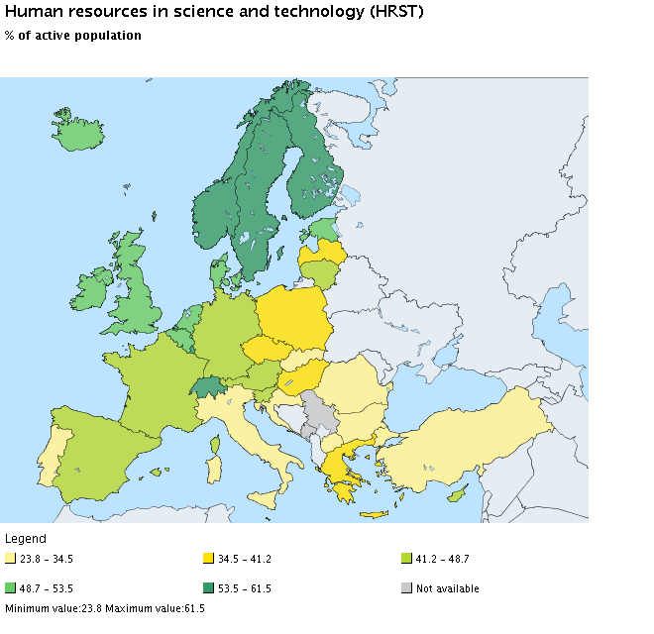
Reallocation of study places & monitoring of graduates
Contracts with HE institutions: MoE is negotiating and concluding the annual contracts with HEIs on the number of students and graduates «produced», gradually reallocating state subsidized study places for STEM studies
Total funding for state subsidized study places in 2016–85 MEUR.
Register of Students:
The State Education Information System is being extended to include the students’ roll-out in 2016;
The goal for 2017 is to connect the System with the Data base of the State Revenue Service and the State Employment Agency to monitor the success of graduates on the job market (employment and income) and thus analyze the State’s return on the state subsidized study places by programmes, institutions etc.

Slide 9
Performance based funding of HEIs (2nd pillar)
Performance criteria according to policy priorities:
Building HRs in research and technology development
International competitiveness of research
Industry relevance of research
MA students, PhD students, «new» scientists engaged in research - (0.3)
International funding for research and development projects (Horizon 2020 etc.) - (0,25)
Public funding, contract funding by commercial entities – (0.25)
Funding by local governments for regional research projects - (0.1.)
Funding for creative and artistic projects - (0.1)

Slide 10
Support for Accreditaion capacity building
New accrediation regulation:
Professionalization, recomendations and quality monitoring, competitive costing, lean operation, international accreditation.
Timeline for accreditation capacity building
6 Nov, 2015 – AIC has submitted project application (8.2.4. SO „To provide support for implementation of requirements of EQAR agency " this will contribute to the capacity development of the AIC; total funding – 1.5 MEUR);
End of Nov, 2015 – Decision on project approval;
Jan/ Feb, 2016 – starting the project (2016-2019)
31 Dec, 2017 – submitting compliance assessment (with the ESG) application;
31 Oct, 2018 - submitting an application for accreditation and registering AIC into the EQAR;
Beginning of 2019 – Decision on the fulfillment of conditions.

Slide 11
HORIZON 2020
Corporate income tax allowances for stimulating production when purchasing new production equipment
Corporate income tax allowances for research and development costs
Participation in the EU research and technology development programmes (2014–2017) 5.72 million euro (MoES, NB)
FLP (2014–2017) 20.76 million EUR (IZM, SB)
Technology transfer programme
24.5 million euro (MoE, SF)
Facilitating access to funding 51 million euro (MoE, SF)
Public infrastructure facilitating business in regions 114.2 million euro (MoEPRD, SF)
Reuse of public data 151.54 million euro (MoEPRD, SF)
NRP (2014–2017) 26.96 million EUR. (IZM, SB)
Science base funding (2014–2017) 99.16 million euro (MoES, NB)
Support for small and medium-sized enterprises for the development of new products and technologies 7 million euro (MoE, SF)
Training of the unemployed 24.90 million euro (MoE, SF)
High-growth enterprises
75 million euro
(MoE, SF)
Support for the creation of production infrastructure and purchasing equipment 81.75 million euro (MoE, SF)
Practically oriented research
76.51 million euro (MoES, SF)
EDUCATION FUNDING
Innovation grants to students
34 million euro (MoES, SF)
Competence centres
72.3 million euro (MoE, SF)
Training the unemployed according to the labour market demand 96.4 million euro (MoW, SF)
Cluster programme 6.20 million euro (MoE, SF)
Increasing the business competitiveness
Grants for post-doctoral research
64.03 million euro (MoES, SF)
Knowledge transfer to farmers and people responsible for the management of forests 17.1 million euro (MoA, EAFRD)
Business incubator support programme 31 million euro (MoE, SF)
Territory revitalization 278.26 million euro (MoEPRD, SF)
Improving the professional competence of employed persons 27.03 million euro (MoES, SF)
Strengthening the institutional capacity of scientific institutions
15.25 million euro (MoES, SF)
Support for ERA bilateral and multilateral cooperation projects 32.55 million euro (MoES, SF)
Cooperation between research and agricultural and forestry sectors
2.2 million euro (MoA, EAFRD)
Strengthening the capacity for innovation
Innovation motivation programme 4.80 million euro (MoE, SF)
Labour market preventive reorganization system 1.99 million euro (MoW, SF)
Conquering external markets 31.80 million euro (MoE,SF)
Development of the R&D infrastructure 100 million euro (MoES, SF)
Increasing the scientific competitiveness
Latvian economic growth
SCIENCE
BUSINESS
EDUCATION
Reduction of HE study programme fragmentation, strengthening the capacity of HE academic personnel, improving the HE management 65.15 million euro (MoES, SF)
HE infrastructure development in STEM fields
44.64 million euro (MoES, SF)
Infrastructure development in colleges in STEM fields 14.2 million euro (MoES, SF)
Education based in the work environment, practical training in vocational education 21.93 million euro (MoES, SF)
Development of the infrastructure of vocational, including in STEM fields, 104.7 million euro (MoES, SF)
Notes:
RIS3: Enabling role of gvernment
1) Policies that targer whole innovation cycle.

